Slide 1
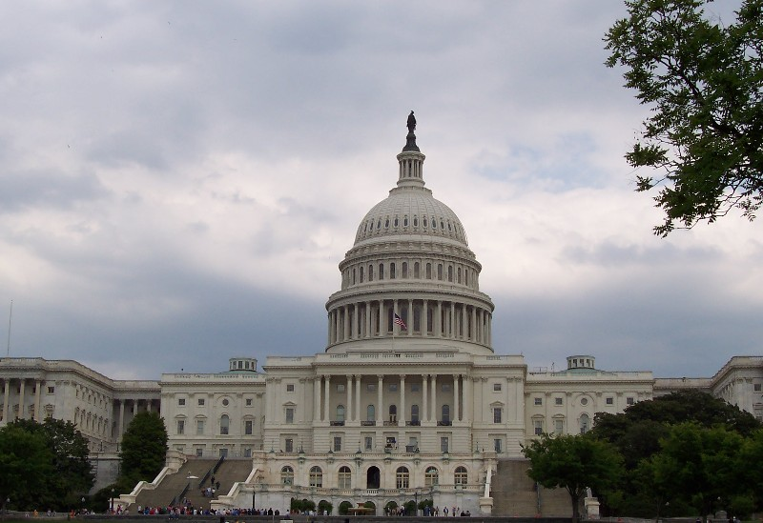
Being a Veteran’s Advocate
The VFW’s National Legislative Service

Slide 2
Our Guiding Principle for Activism
All politics is local
Your influence count, so use it!

Slide 3
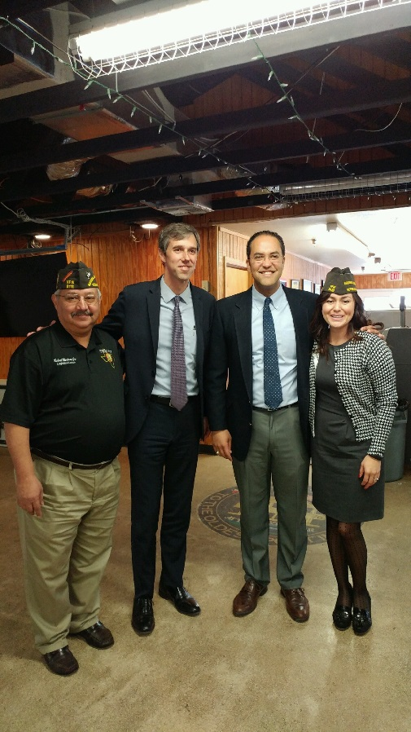
Legislative Advocate Job Responsibilities
Be the Face of VFW with Congress
Build relationships with Members
and their staff
Be the veteran they turn to for ideas and answer

Slide 4
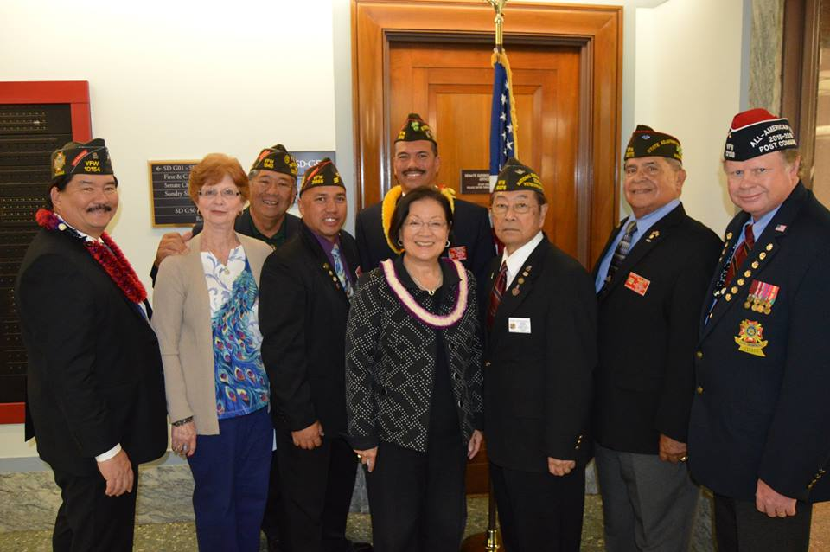
Legislative Advocate Job Responsibility
Coordinate involvement
Respond to action alerts
Recruit others to be involved
Action Corps – passive
Grassroots POC - active
Promote attendance
Town hall meeting
Campaign stops
Set up/ assist
Town hall meetings
Campaign stops

Slide 5
You can contact the National Legislative Service anytime with questions. vfwac@vfw.org or 202-608-8363 Thank you for all that you do!

